Slide 1
Smart Crop Advisory
System
Empowering Small and Marginal Farmers with Al—Driven Decision Support
Mini Project Presentation |Precision Agriculture 4.0
Team Name A.Praneeth Kumar G.Vijay Raj M.Eshwar sai Charan P.Jayanth

Slide 2
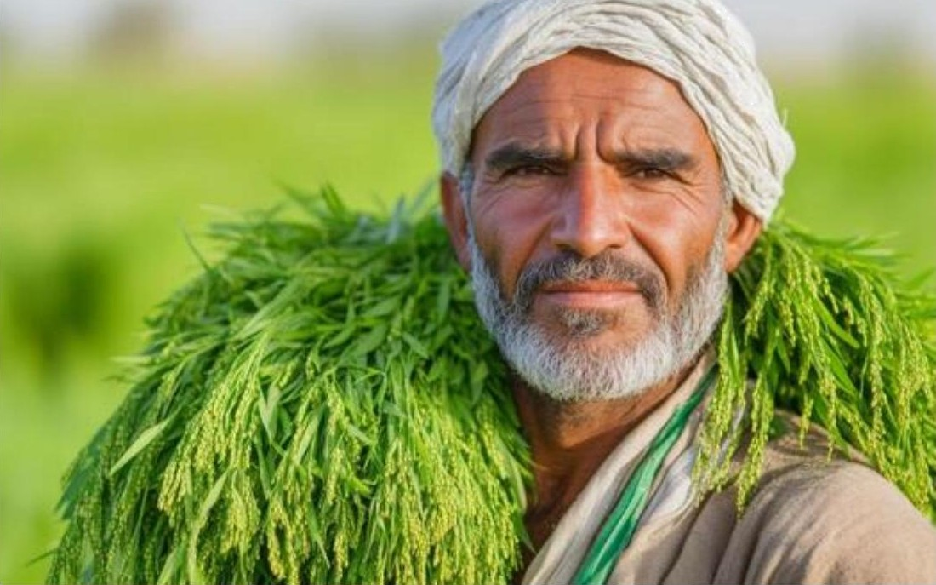
Context & Introduction
Backbone of Economy: Agriculture remains the primary livelihood for over 58% of India's population. However, it is characterized by "Smallholder Vulnerability."
Theoretical Detail: The Smallholder Farmer Theory suggests that fragmentation of land prevents economies of scale, making technical knowledge access the only way to increase productivity.
The Opportunity: Digitalization can bridge the gap between scientific agronomy and field-level execution for marginal households.

Slide 3
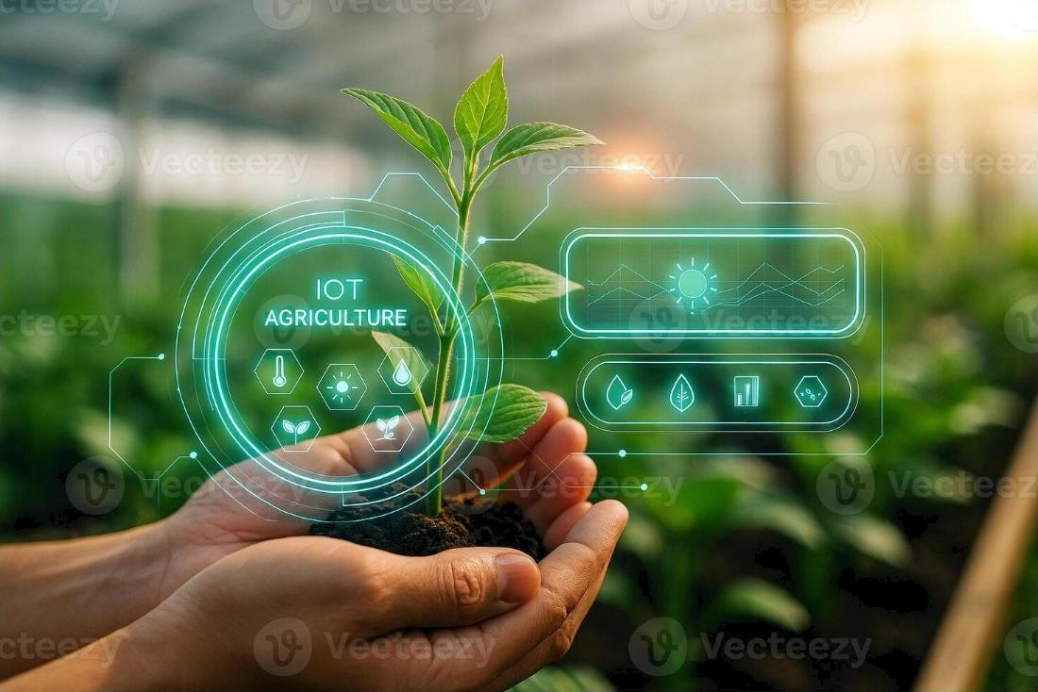
The Problem Statement
Information Asymmetry
Current farming relies heavily on ancestral traditional methods which lack adaptation to changing climate and soil health trends.
Core Issue: There is a critical lack of Real-time Scientiñc Advisory. Farmers often make decisions based on hearsay or generic data that does not apply to their specific micro—climate or soil NPK profile.

Slide 4
Specific Challenges in Small-scale Farming
Low Yield & Productivity
Small farmers often achieve only 50—60% of potential yield due to poor crop selection and lack of early disease detection.
High Input Costs
Economic burden due to wasteful application of water and fertilizers without specific soil requirements.
Ecological Degradation
Overuse of chemicals leading to soil toxicity and the Pesticide Treadmilltheory where pests develop resistance.
Socio-Technical Barriers
Complex scientific reports are often inaccessible due to language barriers and low technical literacy.

Slide 5

The Gravity of the Situation
75dk
Cr Annual Crop Loss (Diseases)
#2
SDG Goal: Zero Hunger
Small & Marginal Farmers
Improving the income of these 86% is not just an agricultural goal, but a socio—economic necessity for rural stability and national food security.

Slide 6
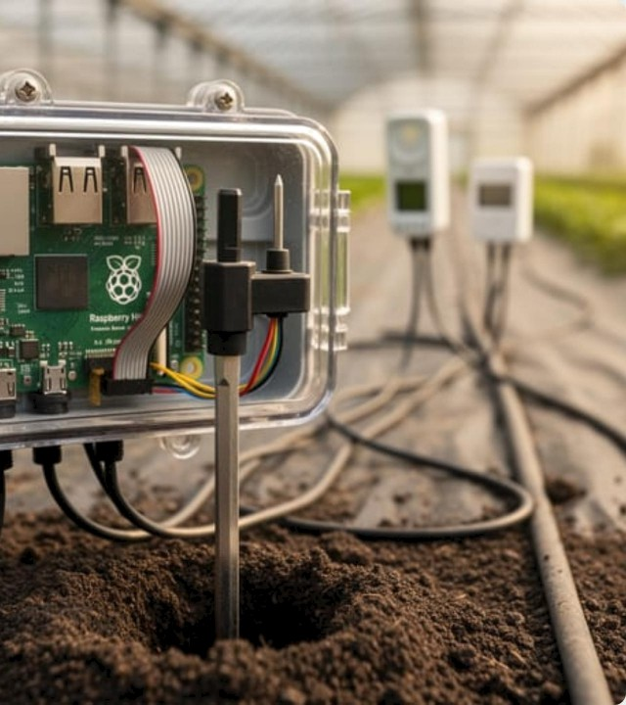
Proposed Solution:
SCAS
A Hybrid AI Decision System
Our solution is a comprehensive Al—based mobile/chatbot platform designed for hyper—local advisory.
System Architecture: It integrates Predictive Analytics (for crop choice) with Generative AI(for natural language interaction) to create a "Virtual Agronomist" in the farmer's pocket.
Provides actionable intelligence instead of raw data, ensuring the farmer knows exactly what to do and when.

Slide 7




Core System Features
Crop Advice
Weather Alerts
Pest Detection
Market Intelligence
Recommending crops based on N-P-K, pH, and local season.
Precision weather forecasting for irrigation scheduling.
Image processing to identify 38+ plant diseases early.
Real-time Mandi prices to avoid distress selling.

Slide 8




System Workflow & Theory
1. Data Acquisition
User inputs soil parameters or captures images of leaves via the mobile app.
2. AI Processing
ML models analyze data against 8,000+ crop profiles and disease datasets.
3. Logic Engine
Rule—based engines combine weather, price, and soil data for personalized advice.
4. Human Delivery
Recommendations sent via chatbot in local regional languages.

Slide 9
Stakeholder Ecosystem
 |  | Key Benefit
Farmers | End Users / Data Providers | Improved Profit & Reduced Risk
Government | Policy Support / Subsidies | Food Security & Rural Stability
NGOs | Last—mile Connectivity | Empowering Vulnerable Groups
Agri—Companies | Inputs / Market Linkage | Sustainable Supply Chain

Slide 10
Core Advantages of the System
User-Centric Design: Simplified UI tailored for users with low technical exposure, using intuitive icons and voice feedback.
Multilingual Accessibility: Breaks the language barrier by providing advice in 7+ Indian regional languages.
Scientific Precision: Moves farming from "Guesswork" to "Evidence—based" through data—driven fertilizer management.
@ Real-time Scalability: Cloud—based architecture allows the system to serve millions of farmers simultaneously without latency.

Slide 11
The Road Ahead
IoT Edge Integration
Direct deployment of soil sensors (NPK, pH) in fields for automated data logging without manual entry.
Blockchain for Traceability
Using Distributed Ledger Technology to track crop journey from seed to table, increasing trust and export value.
3. Advanced Predictive Modeling
Blockchain Agriculture
Deep learning for long—term climate impact prediction and carbon credit calculations for sustainable farming.

Slide 12
Conclusion
Smart Crop Advisory Systems are not just technology tools; they are instruments of socio—economic change. By providing marginal farmers
with the same scientific insights available to large—scale industrial farms, we democratize precision agriculture and ensure a sustainable future for the backbone of our nation.

Slide 13
Thank You!

